Slide 1
Systems Thinking and Evaluation Beverly Parsons, PhD Patricia Jessup, PhD InSites www.insites.org
Notes:
Evaluation from a Self-organizing Versus Predictive Systems Perspective: Examples from the Field
7/15/12
AE.07.SOvsPSPrsntn.10-24.ppt
1

Slide 2
Overview of Workshop
Introductions
Basic Systems Concepts
Applying Systems Concepts to Oregon Paint Stewardship Program Evaluation
Applying Systems Concepts to Your Own Evaluations
Continual Learning about Systems and Evaluation
Notes:
Evaluation from a Self-organizing Versus Predictive Systems Perspective: Examples from the Field
7/15/12
AE.07.SOvsPSPrsntn.10-24.ppt
2

Slide 3
Learning Outcomes
Understand basic systems concepts
What is a system
System dynamics
Seeing, understanding, and influencing patterns in complex social-ecological systems
Apply systems concepts to evaluation of environmental programs
Develop commitment to ongoing learning and practice of a systems orientation in environmental program evaluation
Notes:
Evaluation from a Self-organizing Versus Predictive Systems Perspective: Examples from the Field
7/15/12
AE.07.SOvsPSPrsntn.10-24.ppt
3

Slide 4
Phases of Evaluation: Terminology
Design Evaluation
Shape Practice
Collect Data
Make Meaning from Data
Notes:
Evaluation from a Self-organizing Versus Predictive Systems Perspective: Examples from the Field
7/15/12
AE.07.SOvsPSPrsntn.10-24.ppt
4

Slide 5
What is a System?
Notes:
Evaluation from a Self-organizing Versus Predictive Systems Perspective: Examples from the Field
7/15/12
AE.07.SOvsPSPrsntn.10-24.ppt
5

Slide 6
What is a System?
A system is an interconnected set of elements that is coherently organized in a way that achieves something.
Notes:
7/15/12
AE.07.SOvsPSPrsntn.10-24.ppt
6

Slide 7
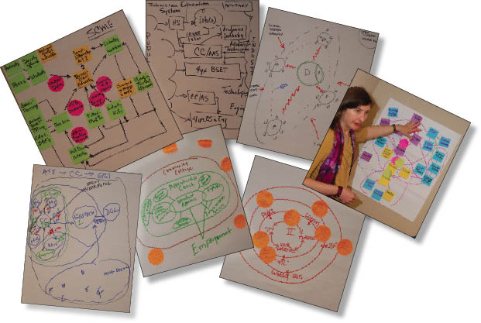
One View of Systems
Notes:
7/15/12
AE.07.SOvsPSPrsntn.10-24.ppt
7
Recall that each of the six SEEs drew diagrams

Slide 8
Complex Adaptive System (CAS) Self-organizing System
A collection of individual agents who have the freedom to act in unpredictable ways, and whose actions are interconnected such that they produce system-wide patterns.
Agents interact

Slide 9
Complex Adaptive System (CAS) Self-organizing System
Those system-wide patterns, in turn, influence the behaviors of the agents
System-wide patterns emerge
Agents interact
Courtesy of G. Eoyang, Human System Dynamics Institute

Slide 10
What is a Complex System? (Working Definition)
A complex system is a collection of independent (and/or semi-autonomous), self-organizing entities that interact so that they create patterns that influence future interactions.
Notes:
7/15/12
AE.07.SOvsPSPrsntn.10-24.ppt
10

Slide 11
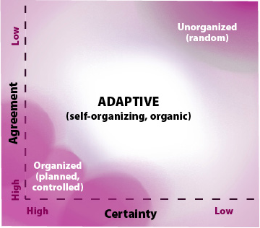
System Dynamics Related to Certainty and Agreement

Slide 12
Oregon Paint Stewardship Program
Integrating Systems Concepts
Logic Model
Evaluation Questions
Evaluation Findings
Phase 2 Evaluation
Notes:
Evaluation from a Self-organizing Versus Predictive Systems Perspective: Examples from the Field
7/15/12
AE.07.SOvsPSPrsntn.10-24.ppt
12

Slide 13
Oregon Paint Stewardship Program’s Initial Logic Model

Slide 14
Oregon Paint Stewardship Program’s System Thinking Ideas

Slide 15
OPSP’s Fuzzy Logic Model (Systems-Oriented Logic Model)

Slide 16
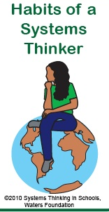
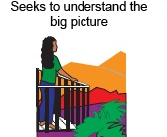
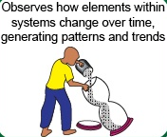
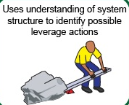
System Thinking Habits
The Big Picture
Change Over Time
Leverage
System Structure
©2010 Systems Thinking in Schools, Waters Foundation
Notes:
7/15/12
AE.07.SOvsPSPrsntn.10-24.ppt
16

Slide 17
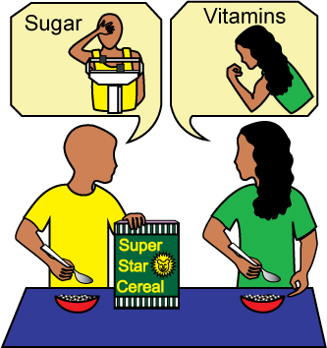
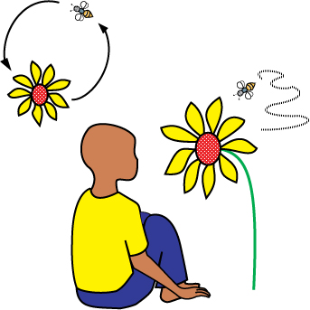
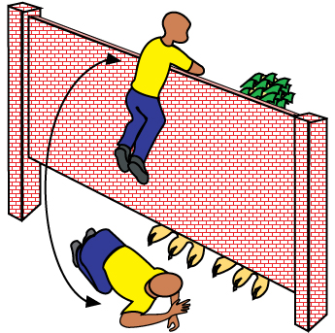
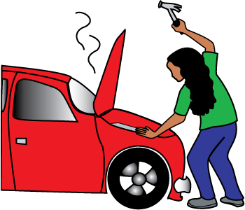
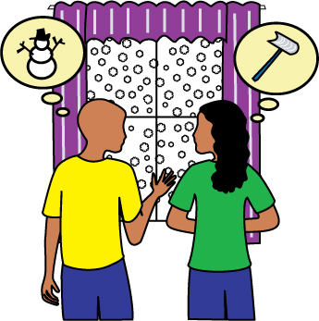
System Thinking Habits (cont.)
Interdependencies
Assumptions
Identifies the circular nature
of complex cause & effect relationships (interdependence)
Surfaces and tests assumptions
©2010 Systems Thinking in Schools, Waters Foundation
Perspectives
Mental Models
Considers Issue Fully
Changes perspectives
Considers how mental models (i.e., attitudes & beliefs derived from experience) affect current reality and the future
Considers an issue fully and resists the urge to come to a quick conclusion
Notes:
7/15/12
AE.07.SOvsPSPrsntn.10-24.ppt
17

Slide 18
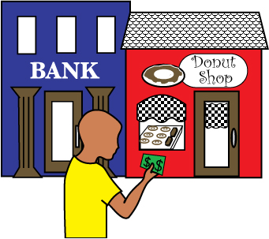
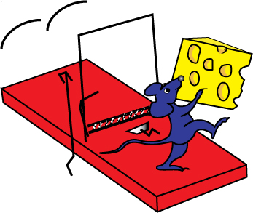
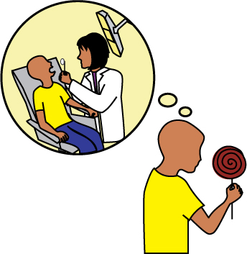
System Thinking Habits (cont.)
Consider Consequences
Unintended Consequences
Considers both short- and long-term consequences of actions
Finds where unintended consequences emerge
Successive Approximation
Time Delays
Recognizes the impact of time delays when exploring cause & effect relationships
Checks results and changes actions if needed: "successive approximation"
©2010 Systems Thinking in Schools, Waters Foundation
Notes:
7/15/12
AE.07.SOvsPSPrsntn.10-24.ppt
18

Slide 19
ZIPPER
Z = Zooming in and out of evaluand and its environment.
I = Interconnecting the parts
P = Plunging into paradigms, structures, processes, conditions
P = Perceiving patterns
E = Envisioning energy
R = Recognizing results
Notes:
Evaluation from a Self-organizing Versus Predictive Systems Perspective: Examples from the Field
7/15/12
AE.07.SOvsPSPrsntn.10-24.ppt
19

Slide 20
Evaluation Questions
Collaboration
Paint Stewardship Organization
Education and Outreach
Consumer Purchasing Decisions
Collection of Post-Consumer Paint
Paint Reprocessing, Recycling, and Energy Recovery
Notes:
Evaluation from a Self-organizing Versus Predictive Systems Perspective: Examples from the Field
7/15/12
AE.07.SOvsPSPrsntn.10-24.ppt
20

Slide 21
Evaluation Questions (cont.)
Household Hazardous Waste Program
Cost Effectiveness
Waste Hierarchy
Market for Post-Consumer Paint
Transferability
Unexpected Results
Notes:
Evaluation from a Self-organizing Versus Predictive Systems Perspective: Examples from the Field
7/15/12
AE.07.SOvsPSPrsntn.10-24.ppt
21

Slide 22
Evaluation Findings
Notes:
Evaluation from a Self-organizing Versus Predictive Systems Perspective: Examples from the Field
7/15/12
AE.07.SOvsPSPrsntn.10-24.ppt
22

Slide 23
Levers for Changing Complex Systems:
Boundaries, Relationships, and Perspectives
Boundaries: Demarcations that create a region/entity
Relationships (interconnections): Connections/exchanges among bounded system parts
Perspectives: Mental models, world views, purposes
From Parsons, B. and Jessup, P. (2009). “Questions that Matter: A Tool for Working in Complex Situations”. Ft. Collins, CO: InSites.
Notes:
Evaluation from a Self-organizing Versus Predictive Systems Perspective: Examples from the Field
7/15/12
AE.07.SOvsPSPrsntn.10-24.ppt
23

Slide 24
Designing Next Evaluation Phase
Oregon Paint Stewardship Program Phase 2 Evaluation
Assumption: Program chooses to focus on reducing consumers’ paint purchase
Two frameworks for finding levers for change
Meadows’ levers
Iceberg (moving to invisible)
Notes:
Evaluation from a Self-organizing Versus Predictive Systems Perspective: Examples from the Field
7/15/12
AE.07.SOvsPSPrsntn.10-24.ppt
24

Slide 25
Places to Intervene in a System (from D. Meadows)
6. Information Flows
5. Rules (incentives, punishments, constraints)
4. Self-organization
3. Goals
2. Paradigms
1. Transcending Paradigms
Notes:
Evaluation from a Self-organizing Versus Predictive Systems Perspective: Examples from the Field
7/15/12
AE.07.SOvsPSPrsntn.10-24.ppt
25

Slide 26
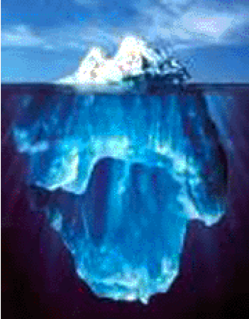
Complex Systems (Illustrating Visibility and Depth)
Events/Behaviors/Results
Patterns
System Dynamics
Structures/Processes
Norms
Principles
Conditions
Paradigms
Notes:
Explain the structures and paradigms issues
Paradigms are strong lever for change – sustainable change; can’t do it without changing.
We are using this for visibility and depth not other features. Make the questions on the right be about the evaluation questions we are asking and show how they go deeper.

Slide 27
Understanding and Influencing Complex Systems
Events, behaviors, results (visible)
patterns
system dynamics
structure & processes
norms
principles
paradigms

Slide 28
Understanding and Influencing Complex Systems
Understanding (Analysis)
Events, behaviors, results (visible)
Influencing
patterns
system dynamics
Relationships
Perspectives
Relationships
structure & processes
Perspectives
Boundaries
norms
Boundaries
principles
paradigms

Slide 29
System Dynamics Related to Certainty and Agreement
More Open
More Diverse
More Differences
Boundaries
Relationships
Perspectives
Closed
Less Diverse
ADAPTIVE
(self-organizing, organic
Few Differences

Slide 30
Influencing System Patterns
Notes:
Evaluation from a Self-organizing Versus Predictive Systems Perspective: Examples from the Field
7/15/12
AE.07.SOvsPSPrsntn.10-24.ppt
30

Slide 31
Domains of the Social Ecology
Societal
Community
Relationships
Individual

Slide 32
System Structures
The parts, relationships, and purposes of systems can create archetypal (generic) system structures that play out over time. These are structures that occur across many different types of systems and situations. They can create both problems and opportunities.
Notes:
7/15/12
AE.07.SOvsPSPrsntn.10-24.ppt
32

Slide 33
System Structural Archetypes
Success to the Successful
Fixes that Fail
Seeking the Wrong Goal
Shifting the Burden
Limits to Growth
Drifting Goals
Rule Beating
Tragedy of the Commons
Escalation
Notes:
7/15/12
AE.07.SOvsPSPrsntn.10-24.ppt
33

Slide 34
Complex Systems (Illustrating Visibility and Depth)
Events/Behaviors/Results
Patterns
System Dynamics
Structures/Processes
Norms
Principles
Conditions
Paradigms
Notes:
Explain the structures and paradigms issues
Paradigms are strong lever for change – sustainable change; can’t do it without changing.
We are using this for visibility and depth not other features. Make the questions on the right be about the evaluation questions we are asking and show how they go deeper.

Slide 35
Understanding and Influencing Complex Systems
Understanding (Analysis)
Events, behaviors, results (visible)
Influencing
patterns
system dynamics
Relationships
Perspectives
Relationships
structure & processes
Perspectives
Boundaries
norms
Boundaries
principles
paradigms

Slide 36
Systems Thinking in Evaluation Summary
Notes:
Evaluation from a Self-organizing Versus Predictive Systems Perspective: Examples from the Field
7/15/12
AE.07.SOvsPSPrsntn.10-24.ppt
36

Slide 37
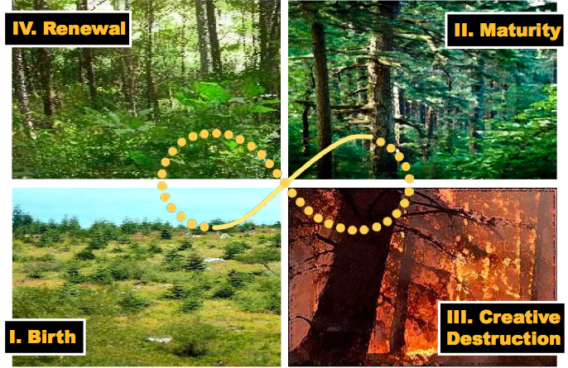
Four Phases of Evaluation
Notes:
Evaluation from a Self-organizing Versus Predictive Systems Perspective: Examples from the Field
7/15/12
AE.07.SOvsPSPrsntn.10-24.ppt
37

Slide 38
Focus on Patterns: A Task
Observe patterns in your home, in a natural setting, or In a city. Describe the patterns in terms of similarities, differences, and connections that have meaning across time and/or location. Look for different patterns of movement:
static pattern (pictures arranged on a wall)
linear movement (timer on the stove counting down to zero from a set time)
nonlinear and unpredictable (birds flying across a lake)
Notes:
Evaluation from a Self-organizing Versus Predictive Systems Perspective: Examples from the Field
7/15/12
AE.07.SOvsPSPrsntn.10-24.ppt
38

